Slide 1
EACPT, 25 June 2017
CPT education in EU needs harmonisation and modernisation
Education Working Group of the European Association of Clinical Pharmacology and Therapeutics (EACPT)
DJ Brinkman, MD
Notes:
ON BEHALF OF THE RESEARCH GROUP I PRESENT

Slide 2
Background
European medical graduates lack essential prescribing competencies (knowledge, skills, attitudes)¹
Possible explanation: poor undergraduate CPT education²
1988: little time devoted to teaching CPT and lack of trained individuals³
How do we currently prepare our medical students in Europe for prescribing as junior doctor?
(1) Brinkman, 2017; (2) Dornan, 2009; (3) Orme, 1990
Notes:
EMA rapport 2006

Slide 3
Aim
To gain insight into the current structure, delivery and assessment of CPT education in European medical schools

Slide 4
Methods
Notes:
4

Slide 5
Methods
Online survey³⁻⁶
- Teaching (years, methods, materials, delivery, contact hours…)
- Assessment (years, methods, integrated, final assessment…)
All medical schools in 28 EU countries
Responsible CPT teacher(s)
(3) Orme, 1990; (4) Heaton, 2008; (5) O'Shaughnessy, 2009; (6) Keijsers, 2015
Notes:
EXCLUSION

Slide 6
Curriculum type
Traditional learning
>50% lectures, self-directed learning, written exams, essays
Problem-based learning
>50% seminars, working groups, role playing, OSCEs, clinics
Notes:
>50% of the methods

Slide 7
Learning objectives
Quality
SMART rubric⁷ (Specific, Measurable, Achievable, Relevant, Time-bound)
Structure
Alignment Miller’s pyramid⁸
Does action
Shows
performance
Knows how
competence
Knows
knowledge
(7) Lockspeiser, 2013; (8); Miller, 1990
Notes:
SELECTED THROUGH EMAIL/ANNOUCEMENTS

Slide 8
Results
Notes:
8

Slide 9
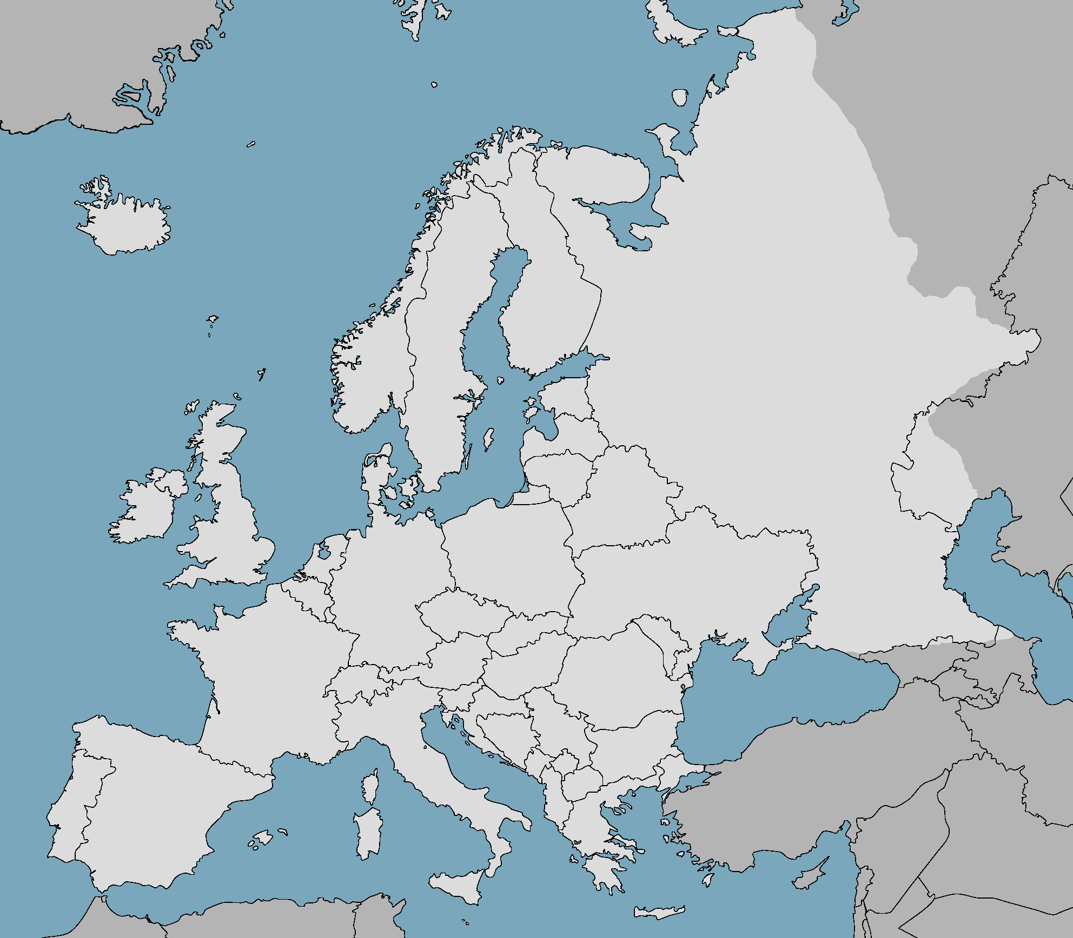
.
.
.
.
290 medical schools invited
185 (64%) schools participated
.
.
.
.
.
.
.
.
.
.
.
.
.
.
.
.
.
.
.
.
.
.
.
.
.
.
.
.
.
.
.
.
.
.
.
.
.
.
.
.
.
.
.
.
.
.
.
.
.
.
.
.
.
.
.
.
.
.
.
.
.
.
.
.
.
.
.
.
.
.
.
.
.
.
.
.
.
.
.
.
.
.
.
.
.
.
.
.
.
.
.
.
.
.
.
.
.
.
.
.
.
.
.
.
.
.
.
.
.
.
.
.
.
.
.
.
.
.
.
.
.
.
.
.
.
.
.
.
.
.
.
.
.
.

Slide 10
% of total schools
Notes:
MEAN RESPONSE RATE 67%

Slide 11
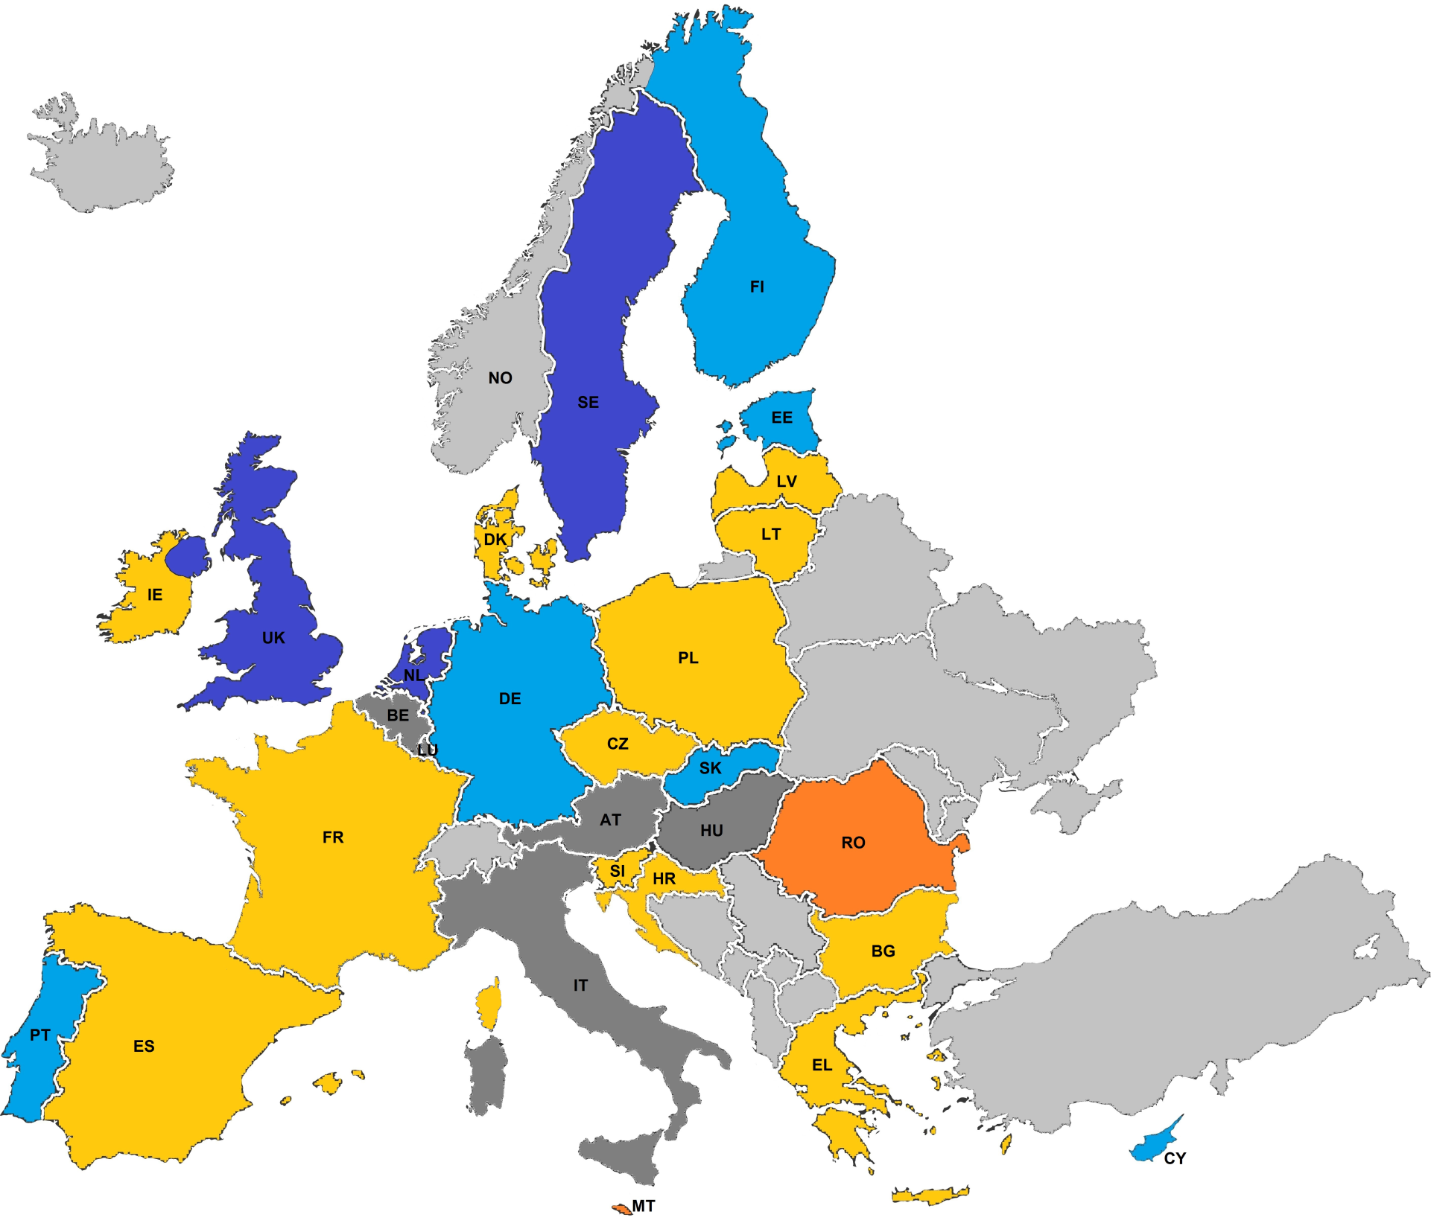
Entirely problem-based learning (>80%)
Mainly problem-based learning (50-80%)
Associated with better knowledge & skills!
Mainly traditional learning (50-80%)
Entirely traditional learning (>80%)
Excluded (<50% schools responded)
Not part of EU
Notes:
MEAN RESPONSE RATE 67%

Slide 12
Teaching
Notes:
12

Slide 13
Study years
% of medical schools
medical curriculum
basic pharmacology
clinical pharmacology
therapeutics

Slide 14
Teaching methods
% of medical schools
traditional-learning
context-based learning
basic pharmacology
clinical pharmacology
therapeutics

Slide 15
Study materials
% of medical schools
written
online

Slide 16
Delivery of CPT
% of medical schools

Slide 17
Prescribing for real patients?
% of medical schools
Notes:
UNDERSUPERVISION

Slide 18
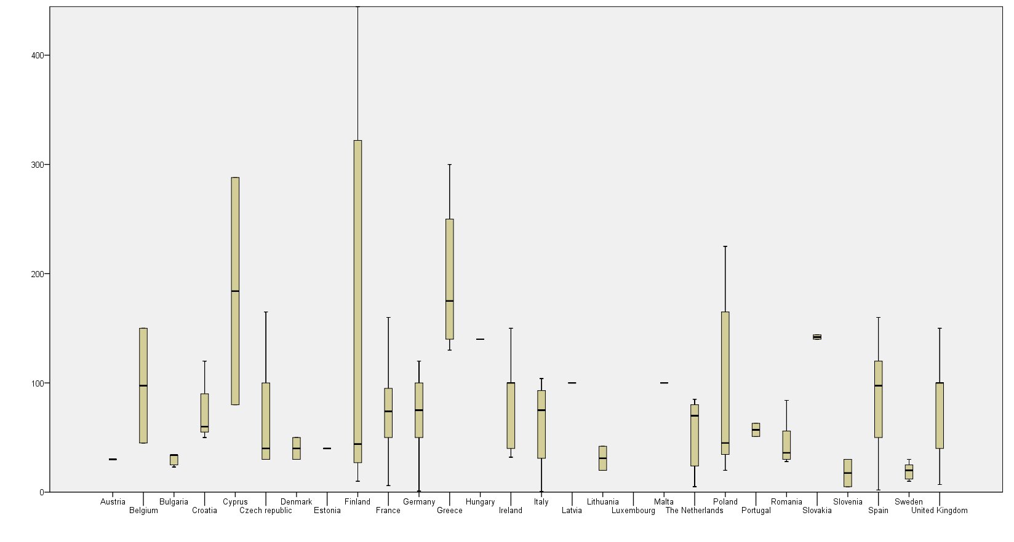
Contact hours per country
number of contact hours
median 68
Notes:
1988: mean was 35 hours

Slide 19
Assessment
Notes:
19

Slide 20
Assessment methods
% of medical schools
teacher-centred
student-centred
basic pharmacology
clinical pharmacology
therapeutics

Slide 21
Separate or integrated assessment?
% of medical schools
Notes:
Not applicable

Slide 22
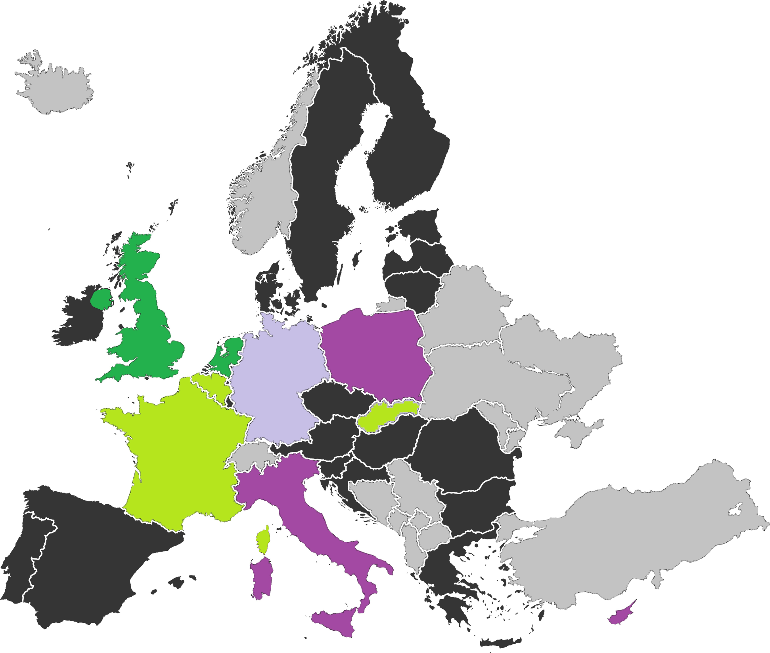
National prescribing assessment
Compulsory part of national exam
‘Final prescribing assessment’
Non-compulsory part of national exam
Part of pre-registration period
No final prescribing assessment
Not part of EU

Slide 23
‘How prepared are your students for prescribing?’
Significantly correlated with the presence of a final assessment (45% versus 17%, P< 0.0001, χ2 test)

Slide 24
Learning objectives
Notes:
24

Slide 25
Quality
153 schools (83%) defined objectives
63 (41%) schools sent document
Specific (SD) | Measurable (SD) | Achievable (SD) | Relevant (SD) | Time-bound (SD) | Mean
1.9 (0.8) | 1.9 (0.8) | 2.0 (0.7) | 1.9 (0.7) | 2.2 (0.9) | 1.9 (0.6)
1= poor, 2= suboptimal, 3= adequate
Notes:
SELECTED THROUGH EMAIL/ANNOUCEMENTS

Slide 26
Structure
Objectives of 83 (54%) schools were not or little aligned with learning and assessment activities
Does - 2%
Shows - 38%
Knows how - 30%
Knows - 32%
therapeutic objectives (n= 376)

Slide 27
Conclusions
Notes:
27

Slide 28
Conclusions
CPT education varies greatly
Mainly based on traditional-learning methods
>66% do not practise real-life prescribing
Almost 50% no final-assessment, often integrated
69% do not consider their students to be well prepared
Objectives suboptimal and little aligned
Notes:
Quantity and quality varies greatly

Slide 29
Recommendations
Notes:
29

Slide 30
Future
Modernization
Training in simulated & clinical context
Online learning resources
Harmonization
Core curriculum with clear learning outcomes*
Final prescribing assessment
* new Delphi study

Slide 31
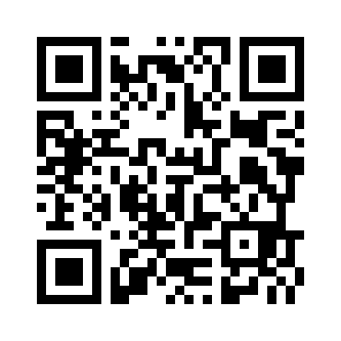
Research team
J. Tichelaar VU University Medical Center
M. Okorie Brighton and Sussex Medical School
L. Bissell Brighton and Sussex Medical School
B. Chamontin University of Toulouse
T. Christiaens Ghent University Hospital J. Costa University of Lisbon
R. Likic University Clinical Hospital Center Zagreb
R. Maciulaitis Lithuanian University of Health Sciences
E. Sanz University of La Laguna
B. Tamba Gr. T. Popa University of Medicine and Pharmacy
M.C. Richir VU University Medical Center
J. Tichelaar VU University Medical Center
S. Maxwell University of Edinburgh
M. van Agtmael VU University Medical Center
Thanks to all 234 CPT teachers who participated in this study!
Contact: d.brinkman@vumc.nl
full article

